Slide 1
GOLDEN CROP DISTRIBUTORS LTD.
By:
ATUGONZA DIANA M25B13/007
MUGISHA ALVIN M25B13/019
ATWINE BENJAMIN M25B13/027
KATUUKA MOSES M25B13/062

Slide 2
PROJECT OVERVIEW
WHAT THE APP CAN POSSIBLY DO…!
Roughly caters for the following;
-Record details
Validate data
Generate receipts
Automatically update stock levels after sales
Providing interactive dashboards
User authentication and authorization
CEO
Manager
Sales Agent
Customers

Slide 3
ABOUT OUR FRONTEND
The frontend of the Golden Crop Distributors application is built as a modern app using React with Typescript(for type safety and maintainability), providing an intuitive and efficient user experience across all devices . It features professional interface with role-based dashboards for example managers , sales , CEO and customers dashboard which allows users to have specified roles and how they interact with the application.
Using React Router for seamless navigation and Chart.js for data visualization, the frontend delivers smooth, dynamic interactions while maintaining consistency across different viewports through CSS grid(for visually appealing layouts). The entire interface is designed with usability as a priority.

Slide 4
Well, The Backend!!
Its built using Node.js with Express.js offering a fast and lightweight server-side solution, RESTful API that handles all business logic, data processing, and secure communication between the frontend and the database.
The backend features comprehensive security through authentication and role-based authorization, ensuring that the different users like managers only access appropriate data and functionalities.
Containerized with Docker for consistent deployment across environments, the backend demonstrates reliability and performance capable for supporting the company’s growing operation needs.

Slide 5
So about the Database
Its Powered by MySQL managed with Type ORM (an ORM for schema management and database queries).
It consists of well-structured tables including users, products etc with appropriate foreign key constraints maintaining referential integrity across all transactions.
The database design supports complex queries for analytical reporting, with indexed fields optimizing performance for frequent operations.

Slide 6
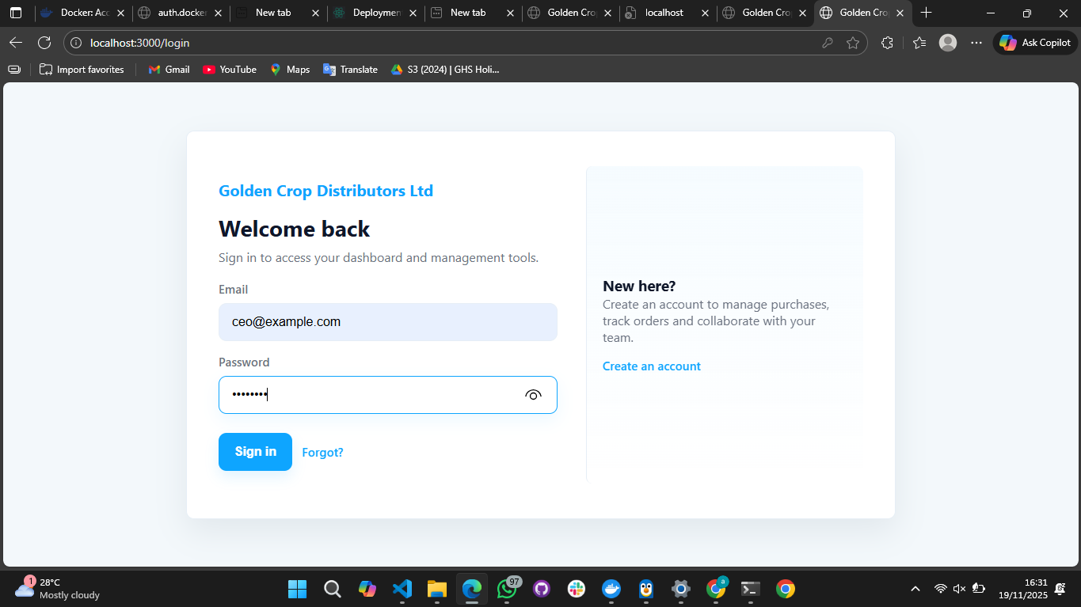
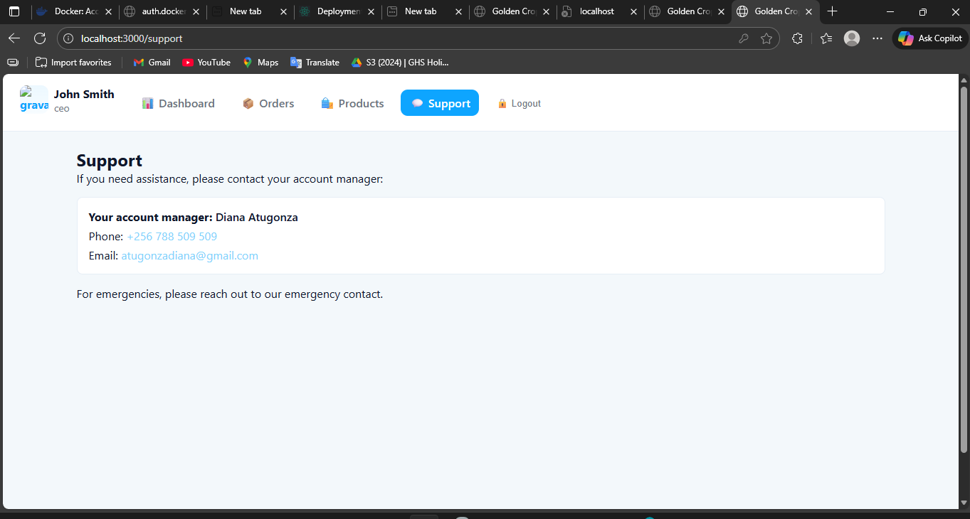
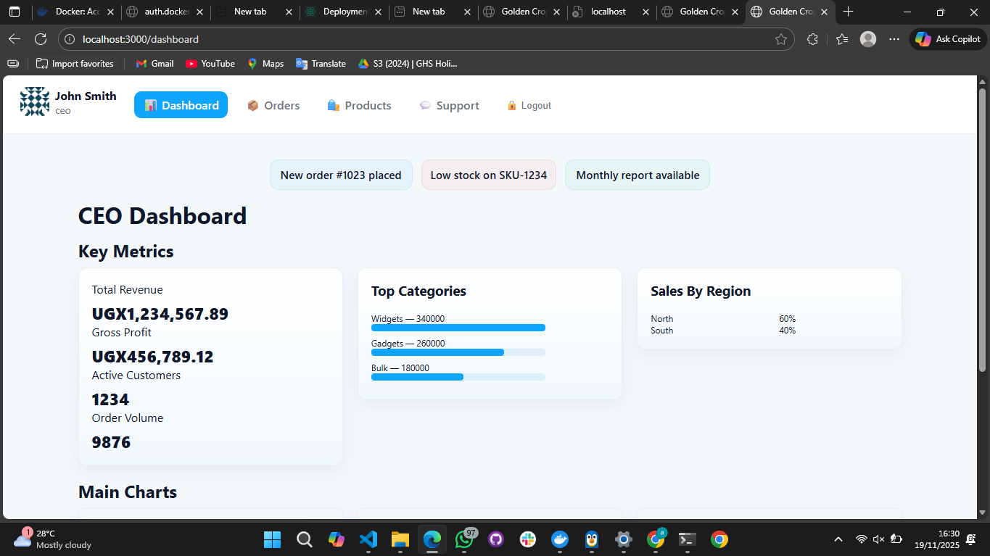
SCREENSHOTS

Slide 7
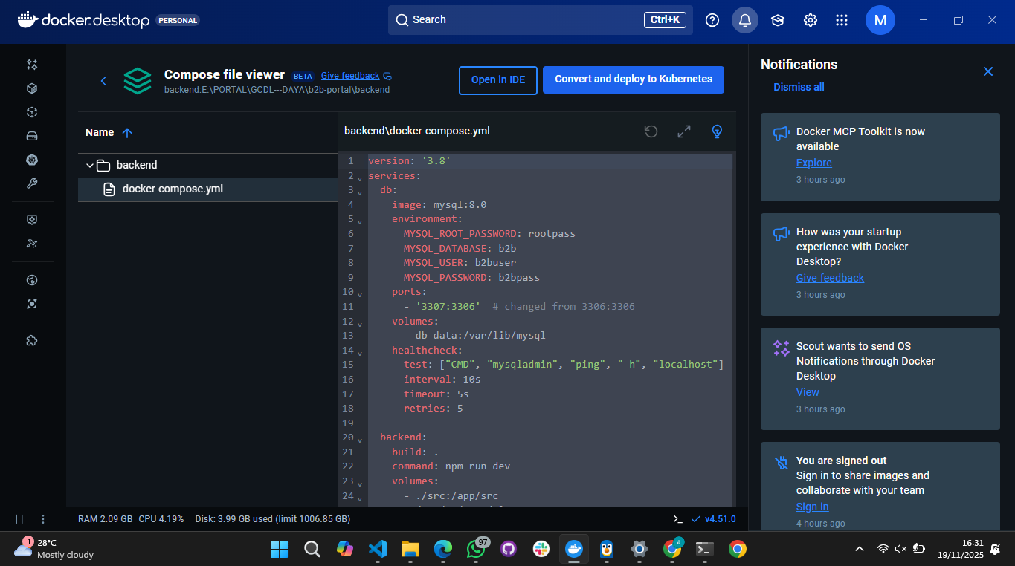
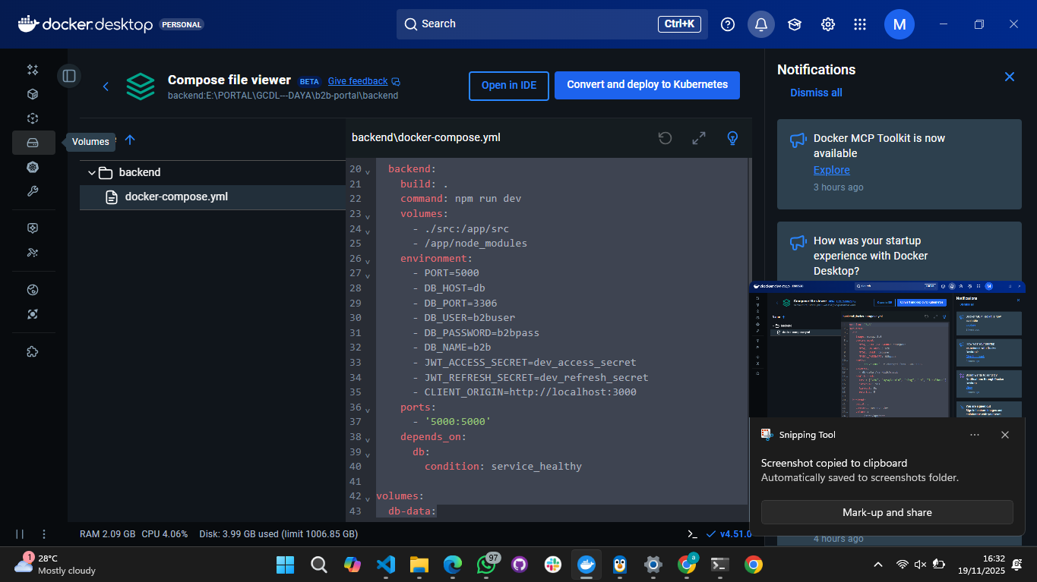

Slide 8
PROCESSES AND ARCHITECTURE
Frontend to Backend communication: The frontend interacts with the backend APIs to retrieve and manage data.
Entity-Relationship Modeling: Type ORM entities define the database structure for products, users and more in the backend.
Seamless Deployment Work flow: Using Docker and docker-compose, all services are containerized for consistency and easy deployment.

Slide 9
DEVELOPMENT PROCESS AND CHALLENGES SOLVED
Key highlight processes
Challenges solved
Local development with mock services(mock.ts) for frontend testing.
-Production support with live database connections and environment variables.
-Regular integration and testing to ensure everything works seamlessly.
Using typescript aids in reducing runtime errors during feature development.
Improved user experience with efficient layouts using react.

Slide 10
In Conclusion;
The Golden Crop Distributors web application represents a comprehensive digital transformation solution that successfully modernizes traditional distribution operations. By leveraging the powerful combination of react with Type script for the frontend, java for the backend ,and MySQL for data management.

